Slide 1
Name: Kunal Narendra Titarmare Team Leader: Akshat Gokani Topic: Fintech Sector and Major Learnings From this programme.
Funds room Internship Programme Week 4 (Module 2)

Slide 2
Content:
About Fintech Sector
Fintech universe
List of fintech unicorns in India.
Major Learning From Module 1
Major Learning From Module 2
Your Business idea from This Sector.
Final Conclusion.

Slide 3

What is Fintech? :
Fintech, short for financial technology, is a term used to describe the integration of technology into a financial service or process, with the goal of enhancing or automating it.
Finance + Technology.
New financial Industries that applies technologies to the financial activates.

Slide 4
Fintech Universe:
Fintech
Payments
Digital banking
Investments
Crowdfunding
P2P lending
Blockchain/cryptocurrency
InsuTech
RegTech

Slide 5
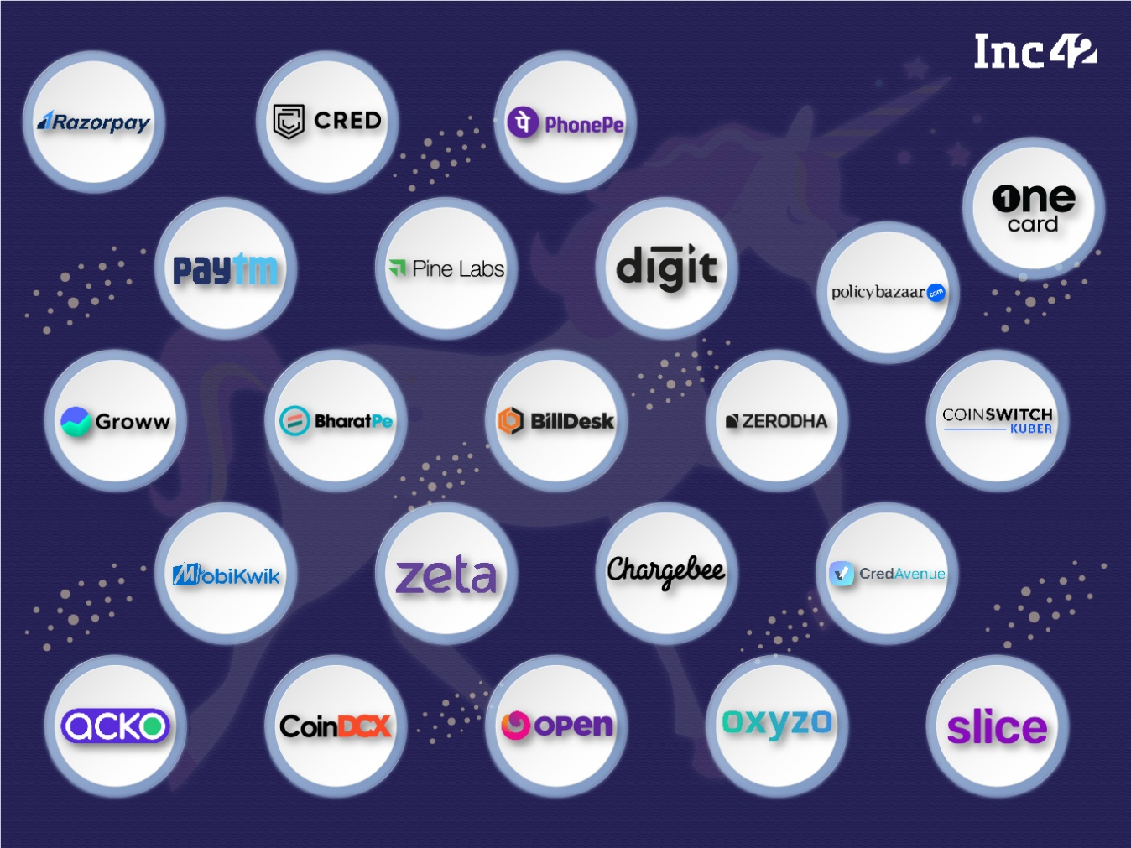
List of Fintech Unicorns In India:
Source: Inc42

Slide 6
Major Learnings From Module 1:
I have learned that Funds room Is a Fintech Start-up. It provides a Platform to invest in multiple Assets under one Roof. It makes your Financial Life better. How we have to work in this Internship and how it will be helpful in Future. Funds room is the best platform for investment and Also provides proper guidance and knowledge of Fundamental and Technical Analysis to their Customers. It helps to be independent Financially.
I have learned about stock market how to invest in stock market also I have learned about how to analyse the stock whether it is good to buy or not by doing fundamental and technical analysis.

Slide 7
Major Learnings From Module 2:
To research the financial market and investment asset classes as per investors need
Perform various research including primary, secondary and survey with regards to market returns, risk and asses various factors
To create fundamental research report which must include all factors asserting to it
To create technical reports which must include all factors asserting to it
To collect the data and create portfolio which included the financial data of the company and the fundamental and technical data
To create POWER-BI report from the data collected and represent it in best possible manner which must clear the financial understanding of the portfolio from investors perspective

Slide 8
Business idea from Fintech sector:
The fintech sector is vast and constantly evolving, offering numerous business opportunities. Here are some business ideas within the fintech sector:
Mobile Payment Solutions: Develop mobile payment apps or platforms that allow users to make transactions seamlessly using their smartphones. This can include peer-to-peer payments, bill splitting, or even NFC-based contactless payments.
Digital Banking Platforms: Create digital banking solutions that provide users with online banking services, such as account management, fund transfers, and loan applications, without the need for physical branches.
Personal Finance Management Tools: Create apps or platforms that help individuals manage their finances more effectively, offering features like budgeting, expense tracking, goal setting, and financial education.
Financial Education Platforms: Build online platforms or apps that provide educational resources, courses, and tools to help people improve their financial literacy and make better financial decisions.
These are just few examples of many possibilities within the fintech sector. The key is to identify the need accordingly we can leverage the technology to address it effectively.

Slide 9
Final Conclusion:
My internship experience at FUNDSROOM has provided me with valuable insights into the dynamic world of stock markets, fundamental and technical analysis techniques, and portfolio management strategies. Through hands-on learning, I have gained proficiency in tools like Power BI, enabling me to visualize and analyse data effectively. This experience has not only deepened my understanding of financial markets but also equipped me with practical skills essential for navigating the fintech industry. I am grateful for the opportunity to learn and grow during my internship, and I am excited to apply these learnings as I continue to pursue a career in finance.

Slide 10
THANK YOU

